Slide 1

FOODIE
Online Food Delivery System
Software Requirements Specification (SRS) · Version 1.1 · 2026
GROUP MEMBERS
2301480
BHAT HARK BAHADUR
2301497
YADAV SUNIL
2301493
SINGH KUSHWAHA GYANENDRA
2301473
YADAV BIBEK

Slide 2
WHAT'S INSIDE
01
Introduction & Scope
06
Non-Functional Requirements
02
System Overview
07
Security & Quality
03
User Roles
08
Roadmap & Gantt Chart
04
Core System Features
09
Diagrams & Descriptions
05
Technical Architecture

Slide 3

Purpose
Connects customers, restaurants, delivery partners, and admins on one scalable platform.
INTRODUCTION
Target Users
& SCOPE
Customers, Restaurant Owners, Delivery Partners, and System Administrators.
Key Objectives
Online ordering, real-time tracking, secure payments, and intelligent delivery assignment.
Document Use
Reference for developers, testers, designers, project managers, and stakeholders.

Slide 4





SYSTEM ARCHITECTURE
How FOODIE Works
Mobile & Web Clients
API Gateway
Microservices
Data Layer
Cloud & DevOps
Android · iOS · Browser
REST · JWT · OAuth 2.0
Order · Auth · Payment · Delivery
MongoDB · Redis Cache
AWS / GCP · Docker · Kubernetes

Slide 5




USER ROLES & RESPONSIBILITIES
Customer
Restaurant Owner
Delivery Partner
Administrator
› Browse restaurants & menus
› Register & manage restaurant
› Accept delivery requests
› Manage all user accounts
› Add items to cart & place orders
› Create & update menu items
› Navigate via map integration
› Monitor all transactions
› Make secure online payments
› Accept or reject orders
› Update delivery status
› Generate system reports
› Track delivery in real-time
› Track incoming orders
› Mark orders as delivered
› View analytics dashboard
› Submit reviews & ratings
› View customer feedback
› View assigned deliveries
› Handle system operations

Slide 6







CORE SYSTEM FEATURES
User Auth
Restaurant Mgmt
Cart & Orders
Payments
JWT-secured registration, login & password reset
Profile, menu & order management for owners
Add items, checkout, order IDs & status tracking
Stripe gateway, cash on delivery & receipts
Delivery Mgmt
Notifications
Reviews & Ratings
Admin Dashboard
Auto-assign riders, real-time GPS tracking
Push, SMS & email alerts at every order stage
Customer ratings and restaurant feedback loop
Analytics, user management & full reporting

Slide 7
REQ-1–5
User Registration, login, JWT auth & password reset
KEY
FUNCTIONAL
REQUIREMENTS
REQ-6–9
Restaurant registration, menu updates & order status
REQ-10–13
Menu add/edit, categories & item availability
REQ-14–17
Cart management, totals, order IDs & status tracking
REQ-1 through REQ-35
REQ-18–21
Online payments, COD, transaction records & receipts
REQ-22–25
Delivery partner assignment, GPS tracking & notifications
REQ-26–28
Push, SMS & email notifications at every order stage
REQ-29–35
Reviews, ratings, admin tools, analytics & reports

Slide 8
TECH STACK
Technologies Powering FOODIE
Frontend
Backend
Database
Android · iOS · Web Browser
Node.js · Express.js · REST APIs
MongoDB · Redis Cache
Cloud
DevOps
Security
AWS · Google Cloud Platform
Docker · Kubernetes · Firebase
SSL · JWT · OAuth 2.0 · HTTPS

Slide 9
NON-FUNCTIONAL REQUIREMENTS
10K+
< 3s
99.9%
< 5s
Concurrent Users
API Response Time
System Uptime
Payment Processing
Reliability:
Availability:
Scalability:
99.9% uptime target
24/7 access guaranteed
Microservices auto-scaling
Maintainability:
Usability:
Security:
Modular architecture
Intuitive cross-platform UI
Encrypted & RBAC-enforced

Slide 10







SECURITY & COMPLIANCE
Password Encryption
HTTPS / SSL
JWT Authentication
bcrypt hashing for all stored passwords
End-to-end encrypted communication
Stateless token-based session management
Role-Based Access
Secure Payments
Data Confidentiality
RBAC enforces permission boundaries
PCI-compliant Stripe gateway integration
User data isolated per role

Slide 11
ROADMAP & FUTURE SCOPE
Phase 1
Phase 2
Phase 3
Future
Core Launch
Delivery & Tracking
Analytics & Ratings
AI & Expansion
✓ User auth & registration
✓ Delivery partner module
✓ Review & rating system
✓ AI-based recommendations
✓ Restaurant & menu management
✓ Real-time GPS tracking
✓ Admin analytics dashboard
✓ Loyalty rewards system
✓ Cart, orders & payments
✓ Push/SMS notifications
✓ Report generation
✓ Multi-language & voice ordering

Slide 12
APPENDIX B
Analysis
Diagrams
Context · Use Case · Architecture · Sequence · Activity · ER · UI Mockup · Implementation · Landing Page

Slide 13
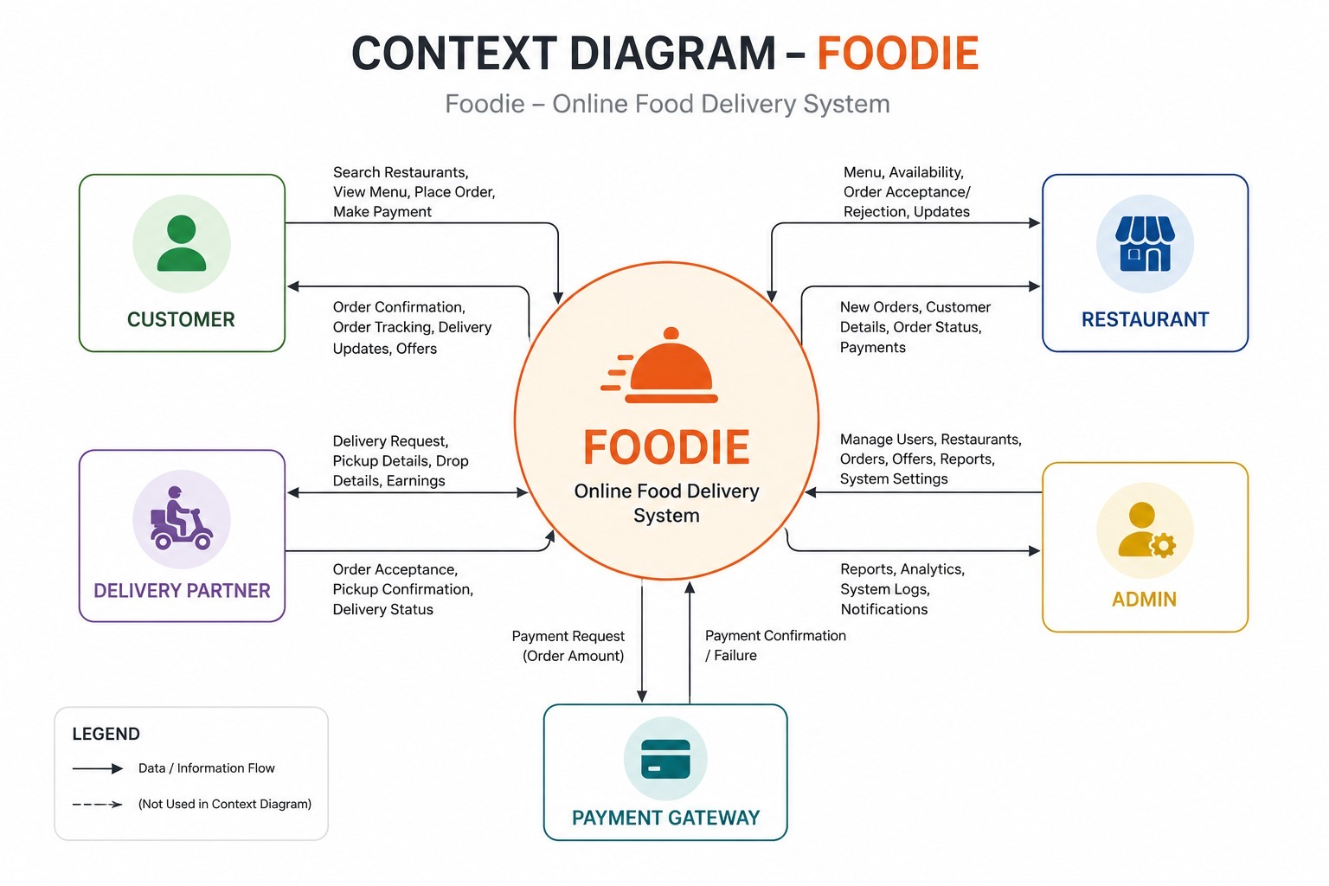
Context Diagram
Data flow between FOODIE and all external actors

Slide 14
Context Diagram — Description
Shows the system as a single process (FOODIE) surrounded by 5 external entities: Customer, Restaurant, Delivery Partner, Admin, and Payment Gateway.
Customer sends: Search, View Menu, Place Order, Make Payment. Receives: Order Confirmation, Tracking, Delivery Updates.
Restaurant sends: Menu, Availability, Order Acceptance/Rejection. Receives: New Orders, Customer Details, Payments.
Delivery Partner sends: Order Acceptance, Pickup Confirmation, Delivery Status. Receives: Delivery Requests, Pickup/Drop Details.
Admin sends: Manage Users/Restaurants/Orders/Reports. Receives: Reports, Analytics, System Logs, Notifications.
Payment Gateway handles Payment Request and returns Payment Confirmation or Failure to the system.

Slide 15
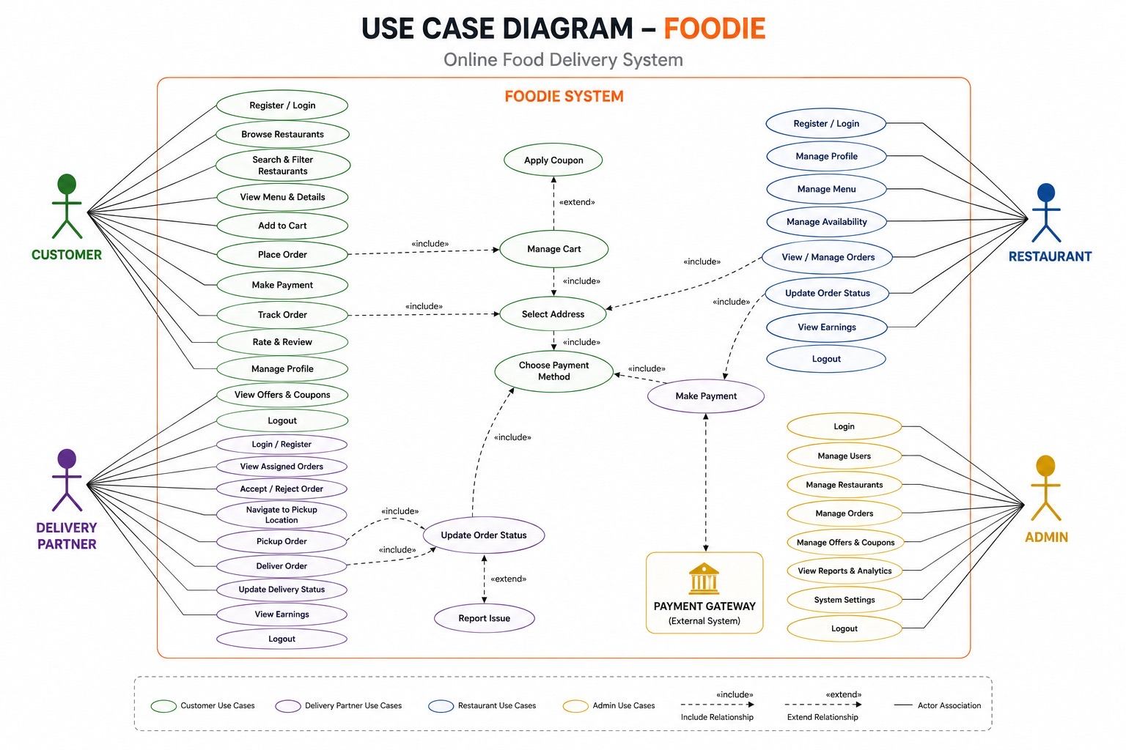
Use Case Diagram
Actor interactions and system use cases for Customer, Restaurant, Delivery Partner & Admin

Slide 16
Use Case Diagram — Description
4 actors: Customer (green), Delivery Partner (purple), Restaurant (blue), Admin (yellow), plus external Payment Gateway.
Customer use cases include: Register/Login, Browse Restaurants, Search & Filter, View Menu, Add to Cart, Place Order, Make Payment, Track Order, Rate & Review, Manage Profile, View Offers.
Core shared use cases use «include»: Place Order → Manage Cart → Select Address → Choose Payment Method → Update Order Status.
Delivery Partner: Login/Register, View Assigned Orders, Accept/Reject Order, Navigate to Pickup, Pickup Order, Deliver Order, Update Delivery Status.
Restaurant: Register/Login, Manage Profile, Manage Menu, Manage Availability, View/Manage Orders, Update Order Status, View Earnings.
Admin: Login, Manage Users/Restaurants/Orders, Manage Offers & Coupons, View Reports & Analytics, System Settings.

Slide 17
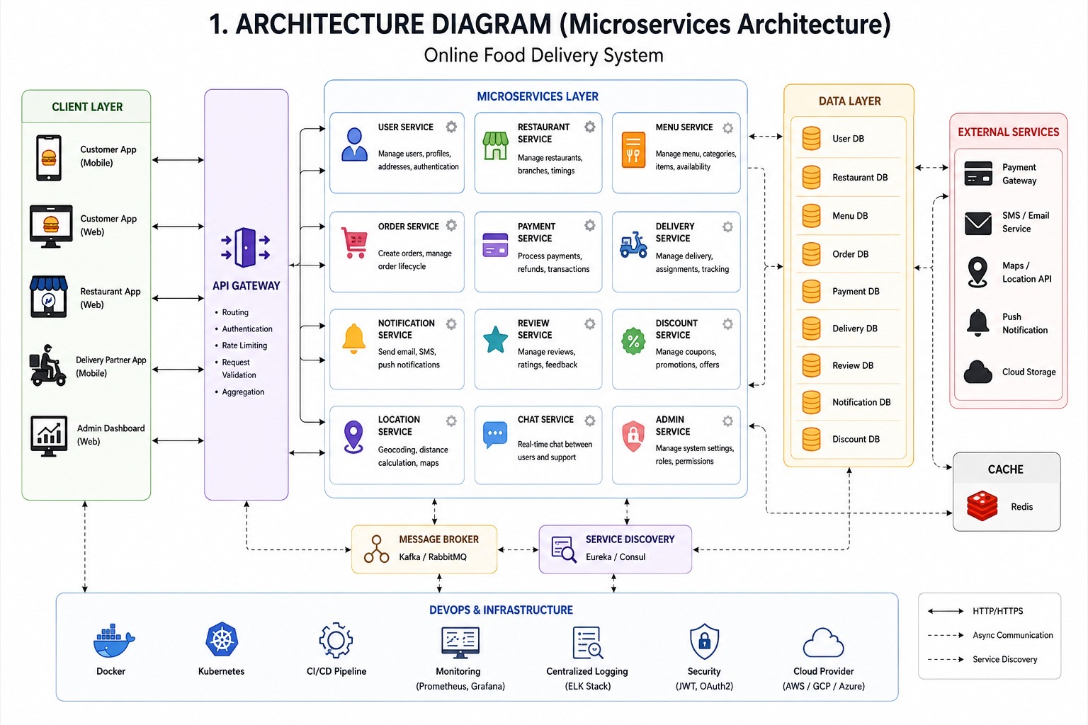
Architecture Diagram — Microservices
Full microservices architecture with 12 services, service discovery, message broker, and DevOps

Slide 18
Architecture Diagram — Microservices — Description
Client Layer: Customer App (Mobile/Web), Restaurant App (Web), Delivery Partner App (Mobile), Admin Dashboard (Web).
API Gateway handles: Routing, Authentication, Rate Limiting, Request Validation, and Aggregation.
12 Microservices: User, Restaurant, Menu, Order, Payment, Delivery, Notification, Review, Discount, Location, Chat, Admin Service.
Data Layer: Separate DB per service (User DB, Restaurant DB, Menu DB, Order DB, Payment DB, Delivery DB, Review DB, Notification DB, Discount DB) + Redis Cache.
Message Broker (Kafka/RabbitMQ) enables async communication. Service Discovery (Eureka/Consul) manages service registration.
External Services: Payment Gateway, SMS/Email Service, Maps/Location API, Push Notification, Cloud Storage.
DevOps & Infrastructure: Docker, Kubernetes, CI/CD Pipeline, Monitoring (Prometheus/Grafana), Logging (ELK), Security (JWT/OAuth2), Cloud (AWS/GCP/Azure).

Slide 19
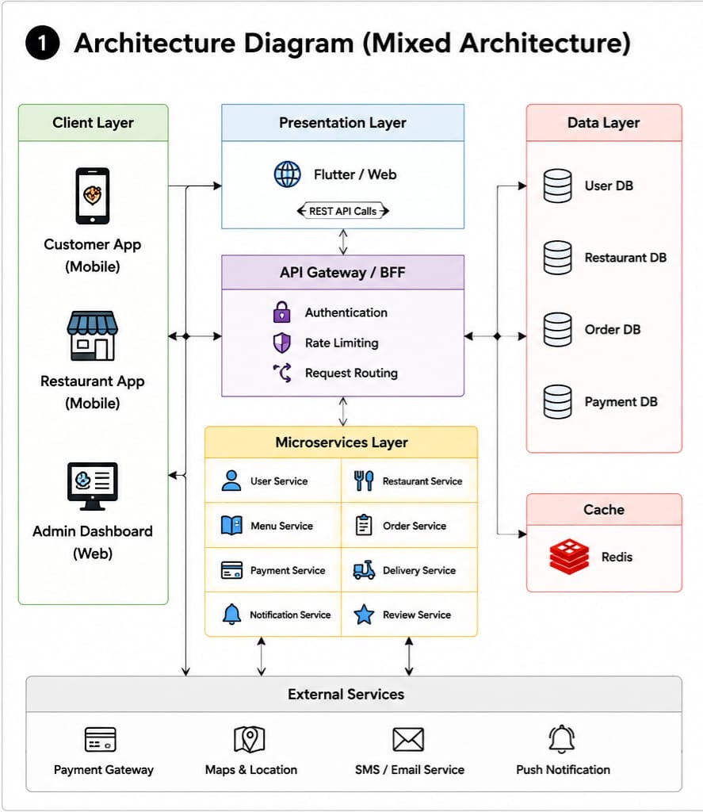
Architecture Diagram — Mixed Architecture
Combined client, presentation, API gateway, microservices, data, and external services layers

Slide 20
Architecture Diagram — Mixed Architecture — Description
Client Layer: Customer App (Mobile), Restaurant App (Mobile), Admin Dashboard (Web).
Presentation Layer uses Flutter/Web with REST API Calls connecting to the API Gateway/BFF.
API Gateway/BFF handles Authentication, Rate Limiting, and Request Routing.
Microservices Layer: User Service, Restaurant Service, Menu Service, Order Service, Payment Service, Delivery Service, Notification Service, Review Service.
Data Layer: User DB, Restaurant DB, Order DB, Payment DB — all independently managed per service.
Cache Layer: Redis for fast data retrieval and session management.
External Services: Payment Gateway, Maps & Location, SMS/Email Service, Push Notification.

Slide 21
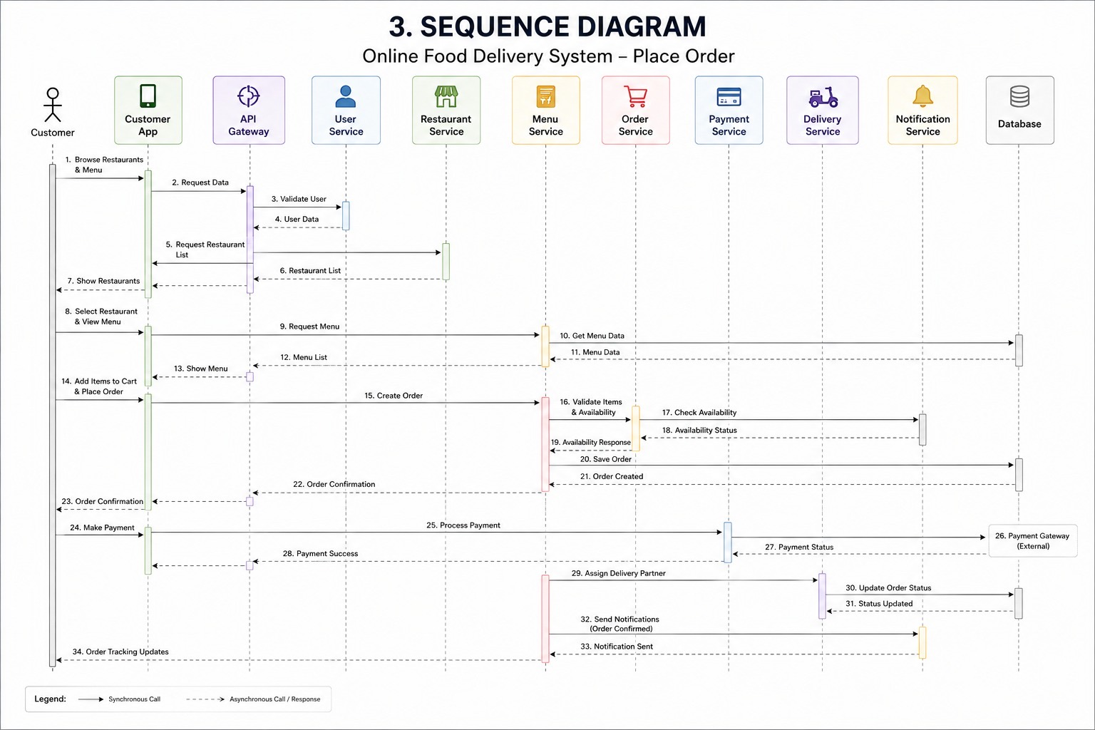
Sequence Diagram
Place Order flow — 34-step message sequence across Customer, App, API Gateway and 9 backend services

Slide 22
Sequence Diagram — Description
Actors/Systems: Customer → Customer App → API Gateway → User Service → Restaurant Service → Menu Service → Order Service → Payment Service → Delivery Service → Notification Service → Database.
Flow Steps 1–7: Customer browses restaurants. App requests data via API Gateway → User Service validates → Restaurant Service returns list.
Steps 8–13: Customer selects restaurant; Menu Service fetches menu items from Database and returns list to App.
Steps 14–21: Customer adds items and places order. Order Service validates item availability with Menu Service, saves order to Database.
Steps 22–28: Order Confirmation sent to customer. Customer makes payment → Payment Service processes → Payment Gateway returns status → Payment success confirmed.
Steps 29–31: Order Service assigns Delivery Partner via Delivery Service → Order status updated.
Steps 32–34: Notification Service sends Order Confirmed notification to customer. Customer receives Order Tracking Updates.

Slide 23
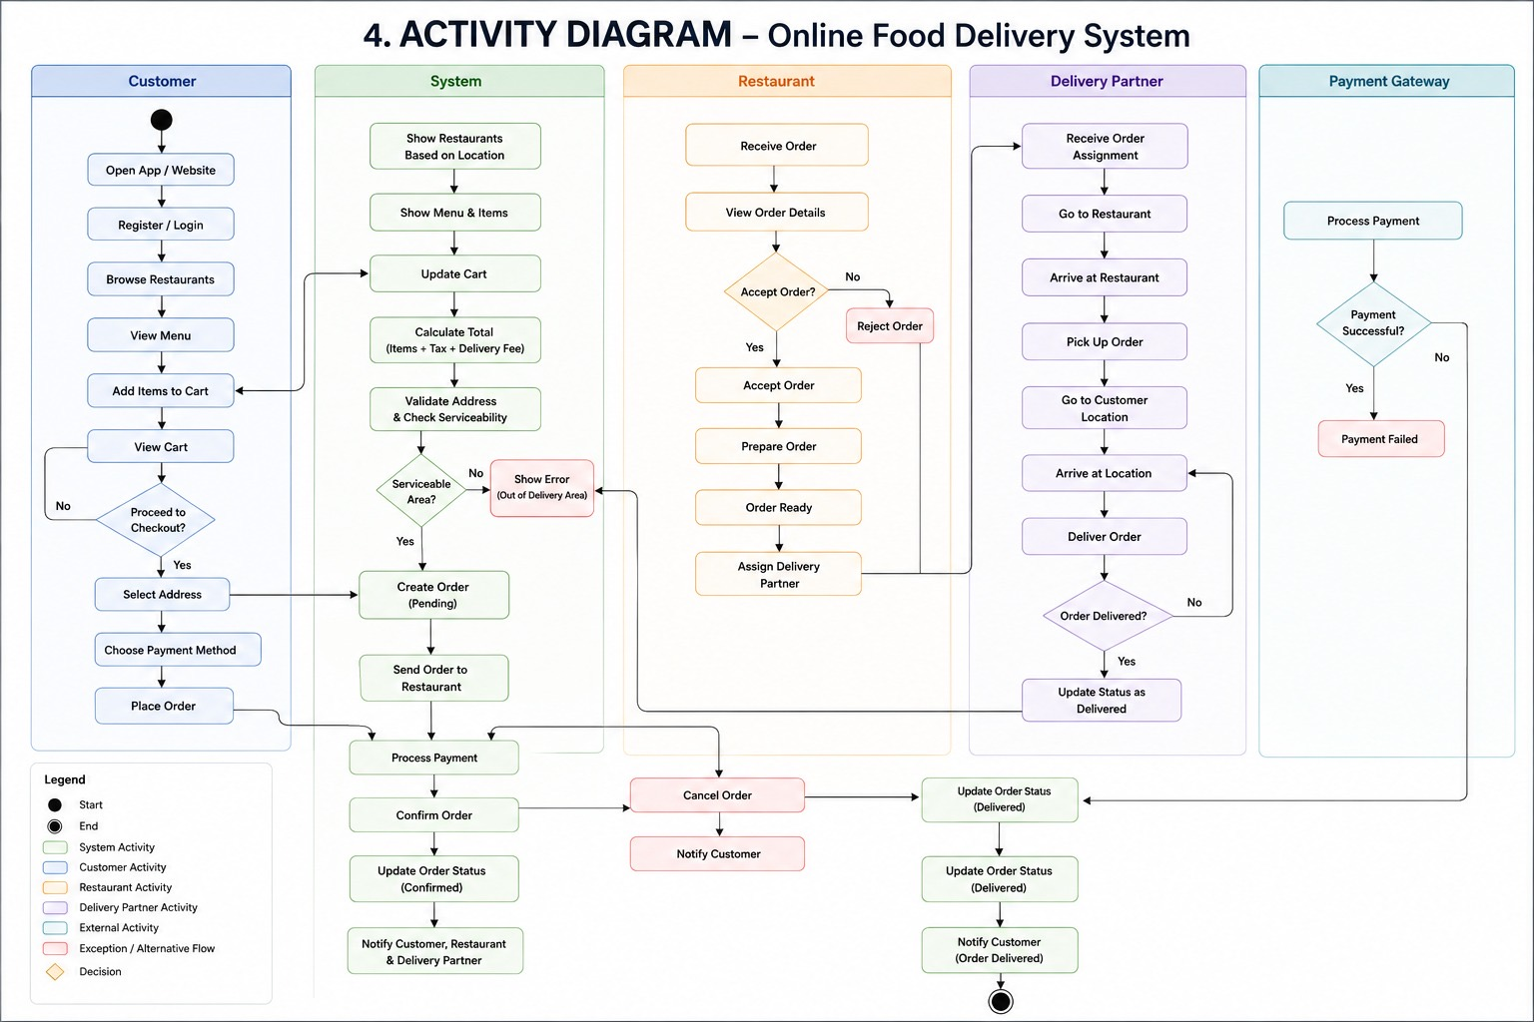
Activity Diagram
End-to-end order flow across 5 swim lanes: Customer, System, Restaurant, Delivery Partner, Payment Gateway

Slide 24
Activity Diagram — Description
5 swim lanes: Customer, System, Restaurant, Delivery Partner, Payment Gateway — showing parallel activities across all actors.
Customer Lane: Open App → Register/Login → Browse Restaurants → View Menu → Add to Cart → View Cart → Proceed to Checkout (decision) → Select Address → Choose Payment → Place Order.
System Lane: Show Restaurants → Show Menu → Update Cart → Calculate Total → Validate Address & Serviceability (decision: serviceable/error) → Create Order (Pending) → Send to Restaurant → Process Payment → Confirm Order → Update Status → Notify all parties.
Restaurant Lane: Receive Order → View Details → Accept Order? (Yes/No decision) → Accept/Reject → Prepare Order → Order Ready → Assign Delivery Partner. Cancel flow: Cancel Order → Notify Customer.
Delivery Partner Lane: Receive Assignment → Go to Restaurant → Arrive → Pickup Order → Go to Customer → Arrive → Deliver Order → Order Delivered? → Update Status as Delivered.
Payment Gateway Lane: Process Payment → Payment Successful? (Yes/No) → confirm success or return Payment Failed.

Slide 25
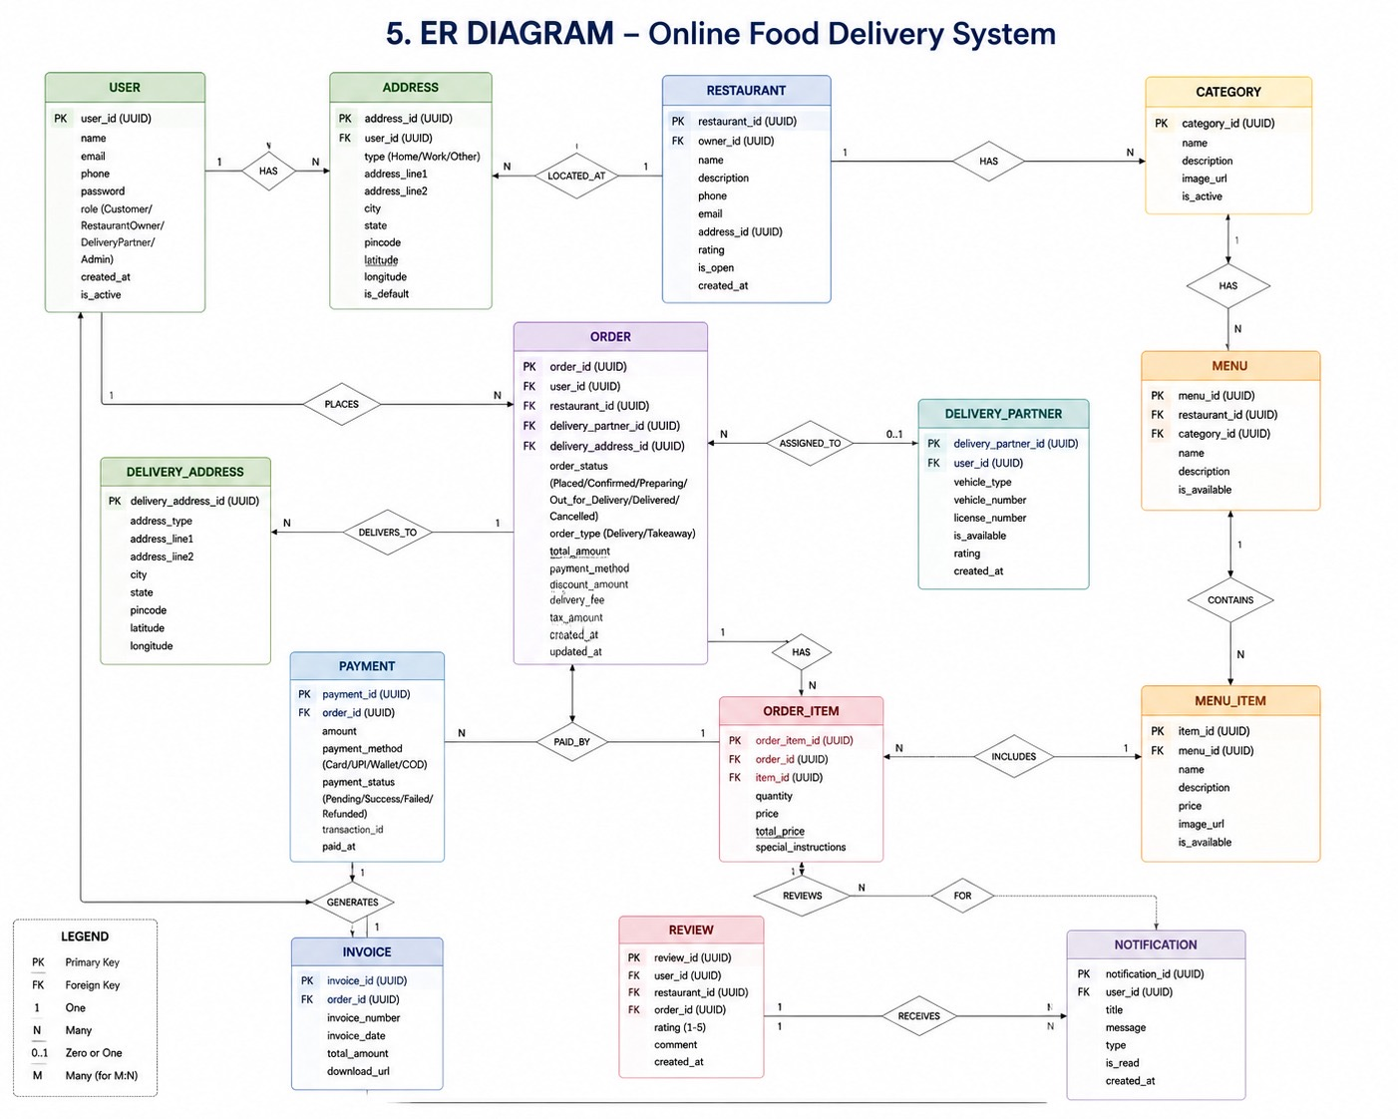
ER Diagram
Entity-Relationship model — 14 entities with primary keys, foreign keys, and cardinality relationships

Slide 26
ER Diagram — Description
14 Entities: USER, ADDRESS, RESTAURANT, CATEGORY, MENU, MENU_ITEM, ORDER, ORDER_ITEM, DELIVERY_PARTNER, DELIVERY_ADDRESS, PAYMENT, INVOICE, REVIEW, NOTIFICATION.
USER has 1-to-N ADDRESS (HAS). RESTAURANT is LOCATED_AT ADDRESS (N-to-1). RESTAURANT HAS CATEGORY (1-to-N). CATEGORY HAS MENU (1-to-N).
MENU CONTAINS MENU_ITEM (1-to-N). ORDER_ITEM INCLUDES MENU_ITEM (N-to-1). USER PLACES ORDER (1-to-N).
ORDER is ASSIGNED_TO DELIVERY_PARTNER (N-to-0..1). ORDER DELIVERS_TO DELIVERY_ADDRESS (N-to-1). ORDER HAS ORDER_ITEM (1-to-N).
PAYMENT is PAID_BY ORDER (N-to-1). PAYMENT GENERATES INVOICE (1-to-1). ORDER_ITEM REVIEWS MENU_ITEM — REVIEW FOR ORDER_ITEM.
NOTIFICATION RECEIVES USER (N-to-1). Key fields include UUIDs as PKs/FKs, status enums, timestamps, and role-based user types.

Slide 27
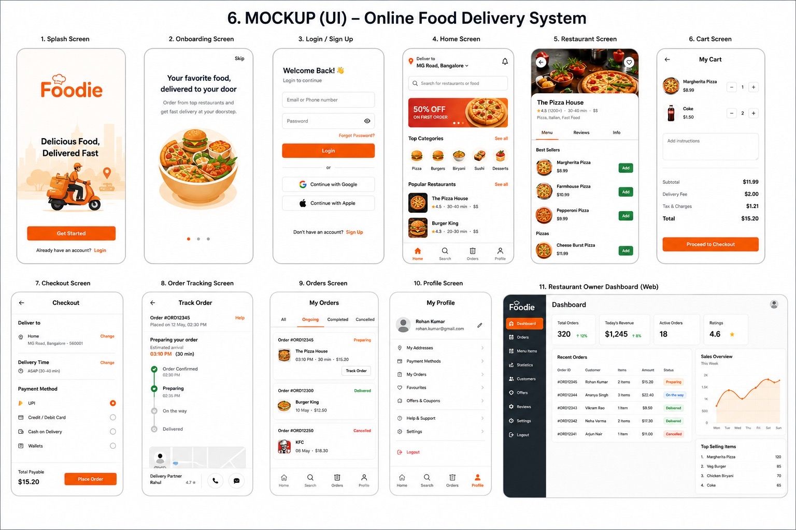
UI Mockup
11-screen mobile UI design + Restaurant Owner Web Dashboard

Slide 28
UI Mockup — Description
Screen 1 — Splash Screen: FOODIE logo with tagline 'Delicious Food, Delivered Fast' and Get Started / Login buttons.
Screen 2 — Onboarding: 'Your favorite food, delivered to your door' with carousel slides and Skip option.
Screen 3 — Login/Sign Up: Email/phone, password, Forgot Password, Login button, Google/Apple sign-in, Sign Up link.
Screens 4–5 — Home & Restaurant: Location-based home with 50% OFF banner, categories (Pizza, Burger, Biryani...), popular restaurants. Restaurant screen shows menu, reviews, add-to-cart.
Screens 6–8 — Cart, Checkout, Order Tracking: Cart with item quantities, subtotal/fees/total. Checkout with delivery address, time, payment method. Tracking screen with real-time order stages and delivery partner info.
Screens 9–10 — Orders & Profile: Orders list with Ongoing/Completed/Cancelled tabs. Profile with addresses, payment methods, favourites, offers.
Screen 11 — Restaurant Owner Web Dashboard: KPIs (Total Orders, Revenue, Active Orders, Ratings), recent orders table, sales chart, top-selling items sidebar.

Slide 29
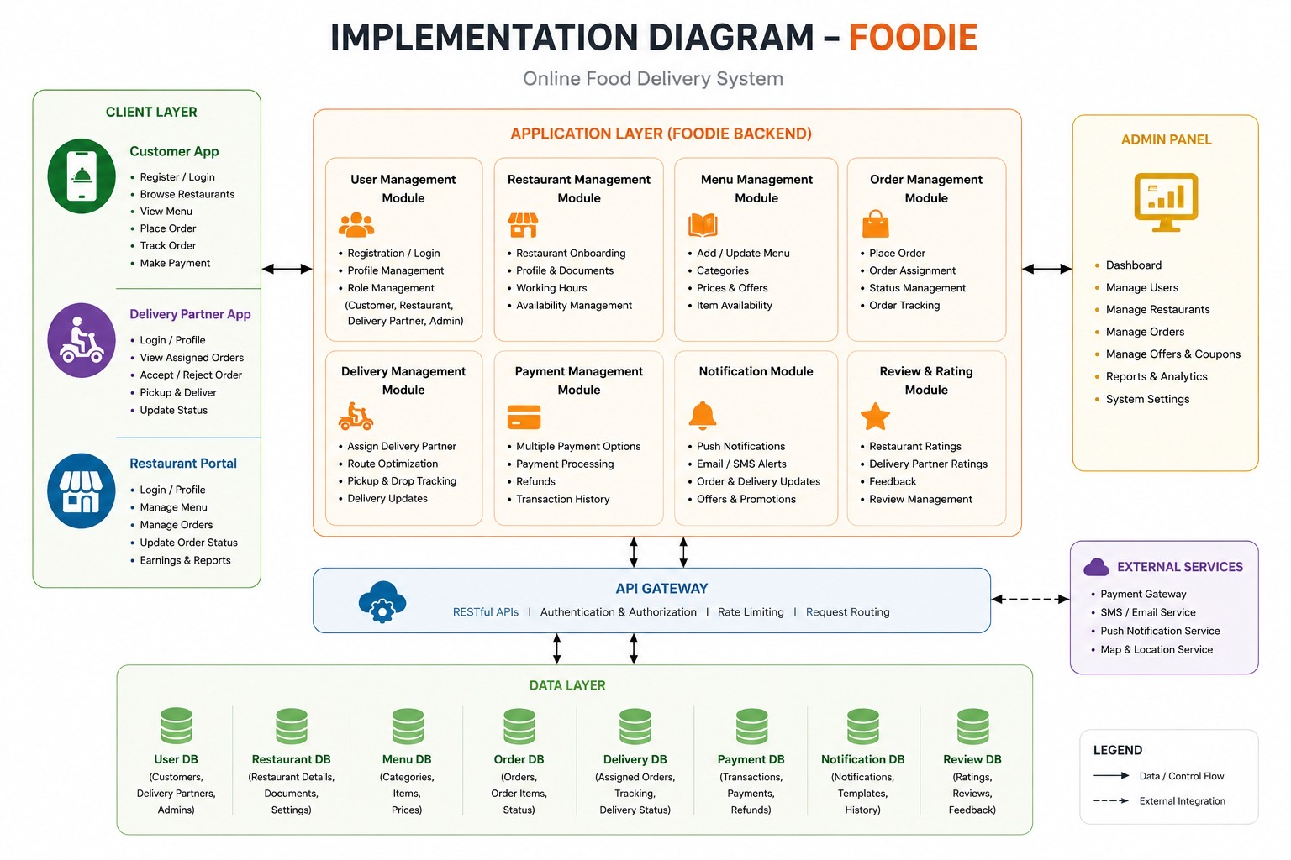
Implementation Diagram
Full module breakdown across Client Layer, Application Layer (Backend), API Gateway, Data Layer and External Services

Slide 30
Implementation Diagram — Description
Client Layer: Customer App (Register/Login, Browse, View Menu, Place Order, Track, Pay), Delivery Partner App (Login, View Assigned Orders, Accept/Reject, Pickup & Deliver, Update Status), Restaurant Portal (Login, Manage Menu, Orders, Status, Earnings).
Application Layer — 8 Modules: User Management (Registration, Profile, Role Management), Restaurant Management (Onboarding, Profile, Working Hours, Availability), Menu Management (Add/Update Menu, Categories, Prices, Item Availability), Order Management (Place Order, Assignment, Status, Tracking).
Delivery Management Module: Assign Delivery Partner, Route Optimization, Pickup & Drop Tracking, Delivery Updates.
Payment Management Module: Multiple Payment Options, Payment Processing, Refunds, Transaction History.
Notification Module: Push Notifications, Email/SMS Alerts, Order & Delivery Updates, Offers & Promotions.
Review & Rating Module: Restaurant Ratings, Delivery Partner Ratings, Feedback, Review Management.
API Gateway: RESTful APIs, Authentication & Authorization, Rate Limiting, Request Routing. Data Layer: 8 separate databases (User, Restaurant, Menu, Order, Delivery, Payment, Notification, Review DB). Admin Panel: Dashboard, Manage Users/Restaurants/Orders/Offers, Reports & Analytics, System Settings.

Slide 31
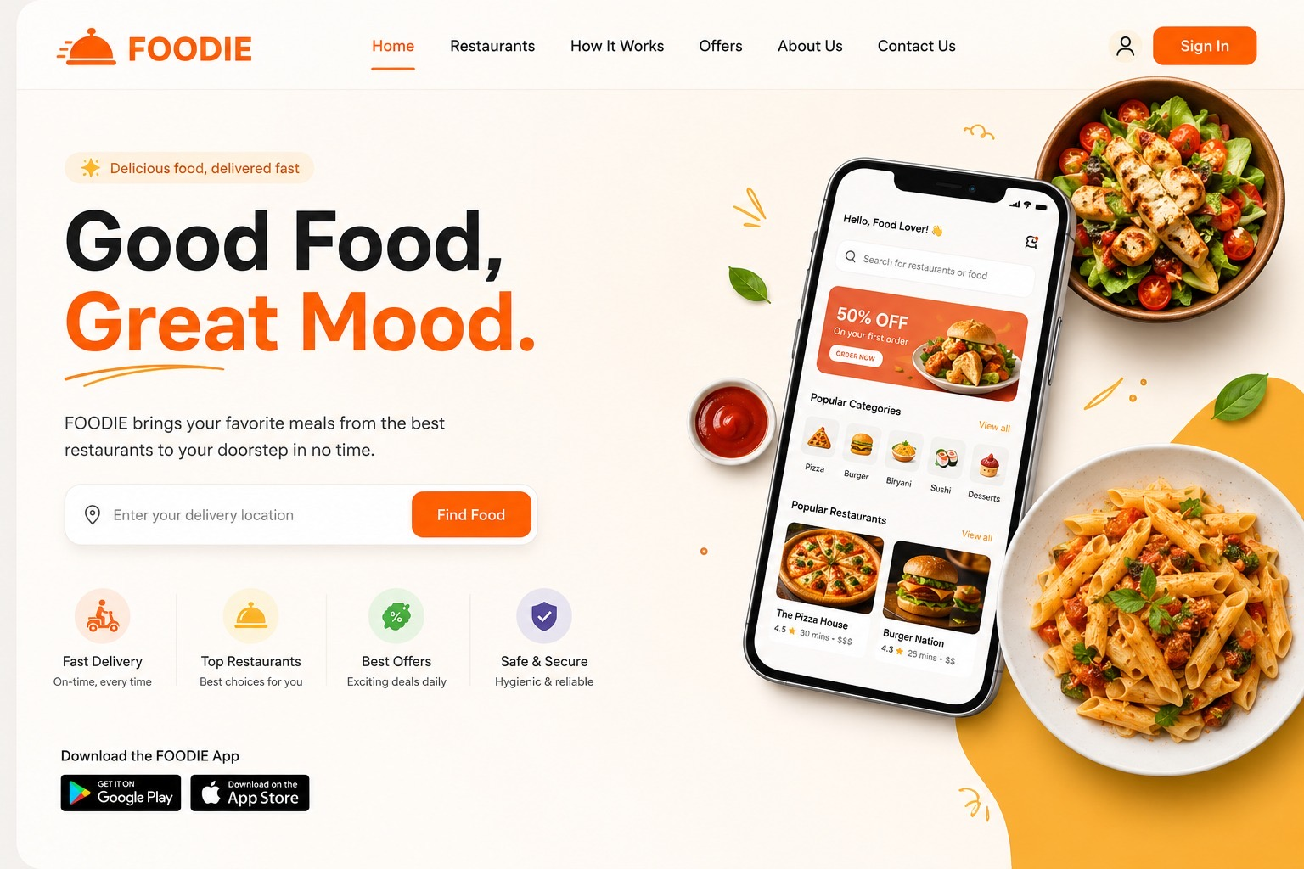
Landing Page Design
FOODIE web landing page — hero section, feature highlights, app store links

Slide 32
Landing Page Design — Description
Navigation Bar: FOODIE logo (with dish icon), links — Home, Restaurants, How It Works, Offers, About Us, Contact Us — and a Sign In button.
Hero Section: Tag 'Delicious food, delivered fast'. Headline: 'Good Food, Great Mood.' Subtext: 'FOODIE brings your favorite meals from the best restaurants to your doorstep in no time.'
Search Bar: 'Enter your delivery location' input with an orange 'Find Food' button for location-based restaurant discovery.
Feature Icons Row: Fast Delivery (On-time, every time), Top Restaurants (Best choices for you), Best Offers (Exciting deals daily), Safe & Secure (Hygienic & reliable).
App Download Section: 'Download the FOODIE App' with Google Play and Apple App Store download buttons.
Right Side Visual: Mobile app mockup showing Home screen with 50% OFF banner, Popular Categories (Pizza, Burger, Biryani, Sushi, Desserts), and Popular Restaurants (The Pizza House, Burger Nation). Surrounded by food photography (salad, grilled chicken, pasta).

Slide 33
PROJECT GANTT CHART
FOODIE – Development Timeline
Mar
Mar
Mar
Apr
Apr
May
Jun
Jun
Requirements Analysis
SRS Documentation
UI/UX Design & Mockups
Database Design (ER)
Architecture Design
Backend Development
Frontend Development
API Integration
Testing & QA
Deployment & Launch
Planning
Design
Development
Testing
Launch

Slide 34
REQUIREMENTS TRACEABILITY MATRIX (RTM)
FOODIE · Part 1 of 2 — FR-01 to FR-20
Req ID
Requirement
Description
Module/Page
Status
FR-01
User Registration
User can create a new account
Register
Complete
FR-02
User Login
User can log in using registered credentials
Login
Complete
FR-03
User Logout
User can log out from the system
Navbar
Complete
FR-04
Session Management
Logged-in user stored in Local Storage
Login/Navbar
Complete
FR-05
Browse Foods
User can view available foods
Home
Complete
FR-06
Search Foods
User can search foods by name
Home
Complete
FR-07
Category Filter
User can filter foods by category
Home
Complete
FR-08
View Food Details
User can see image, name and price
Home
Complete
FR-09
Add to Cart
User can add food items to cart
Home
Complete
FR-10
View Cart
User can view selected items
Cart
Complete
FR-11
Increase Quantity
User can increase item quantity
Cart
Complete
FR-12
Decrease Quantity
User can decrease item quantity
Cart
Complete
FR-13
Remove Item
User can remove cart items
Cart
Complete
FR-14
Cart Persistence
Cart data saved in Local Storage
App.js
Complete
FR-15
Checkout
User can place an order
Checkout
Complete
FR-16
Payment Selection
User selects payment method
Checkout
Complete
FR-17
Order Success
Order confirmation page displayed
OrderSuccess
Complete
FR-18
Order History
User can view previous orders
Orders
Complete
FR-19
Admin Dashboard
Admin page available
Admin
Complete
FR-20
Add Food
Admin can add food items
Admin
Complete
Complete
Partial
Planned
Total: 37 Requirements

Slide 35
REQUIREMENTS TRACEABILITY MATRIX (RTM)
FOODIE · Part 2 of 2 — FR-21 to FR-30 + NFR
Req ID
Requirement
Description
Module/Page
Status
FR-21
Edit Food
Admin can modify food details
Admin
Complete
FR-22
Delete Food
Admin can remove food items
Admin
Complete
FR-23
Food Persistence
Food data saved in Local Storage
Admin/Home
Complete
FR-24
Dynamic Food Display
New foods appear automatically on Home page
Home/Admin
Complete
FR-25
Restaurant Browsing
User can browse restaurants
Home
Complete
FR-26
Delivery Services
User can view delivery services
Home
Complete
FR-27
Delivery Partners
User can view delivery network information
Home
Complete
FR-28
Special Offers
User can view promotional offers
Home
Complete
FR-29
Customer Reviews
User can view testimonials
Home
Complete
FR-30
Responsive Design
Website adapts to mobile and desktop screens
All Pages
Complete
NFR ID
Requirement
Description
Status
NFR-01
Usability
Easy-to-use user interface
Complete
NFR-02
Performance
Fast rendering using React
Complete
NFR-03
Reliability
Data persists through Local Storage
Complete
NFR-04
Maintainability
Modular component-based structure
Complete
NFR-05
Scalability
Can be connected to backend APIs later
Complete
NFR-06
Security
Basic authentication implemented
Partial
NFR-07
Accessibility
Responsive Bootstrap layout
Complete
Complete
Partial
Planned
Total: 37 Requirements

Slide 36
REFERENCES
FOODIE · SRS v1.1
AI TOOLS USED
The following AI tools assisted in content generation, code development, and diagram creation for this project.
01
ChatGPT
02
Claude (Anthropic)
03
GitHub Copilot
GPT-4o · OpenAI
Claude Sonnet · Anthropic
AI Code Assistant · GitHub
Generated SRS documentation, requirement descriptions, use case narratives, RTM content, and Q&A material throughout the project.
Built the PPTX presentation, generated slide layouts, created the RTM slides, and produced structured technical content for diagrams.
Assisted with React component code, JavaScript logic for the FOODIE web app, and auto-completing backend module scaffolding.
04
Gemini
Gemini Pro · Google
Supported brainstorming of system features, activity diagram flow logic, and cross-checking of SRS section content and terminology.
AI tools were used as assistive aids. All final decisions, design choices, and technical specifications were reviewed and approved by the team.

Slide 37
REFERENCES
FOODIE · SRS v1.1
SOFTWARE & DIAGRAM TOOLS
The following software, platforms, and tools were used to build, diagram, design, and document the FOODIE system.
01
Microsoft PowerPoint
02
draw.io / diagrams.net
Presentation · Microsoft 365
Diagramming · JGraph Ltd
Used as the target output format for all slides. Presentation structure, slide layouts, and formatting were planned around PPTX compatibility.
Primary tool for creating Context, Use Case, Architecture, Sequence, Activity, ER, and Implementation diagrams used in the SRS appendix.
03
GitHub
Visual Studio Code
04
Code Editor · Microsoft
Version Control · GitHub Inc.
Development environment used for writing the FOODIE React web application, component code, and all JavaScript/HTML/CSS implementation.
Used for source code version control, team collaboration, branching strategy, and CI/CD pipeline integration for the FOODIE project.
05
Node.js & Express.js
Backend Runtime · OpenJS Foundation
Planned backend framework for FOODIE microservices. REST API structure, routing logic, and service scaffolding follow Express conventions.
Tools listed reflect planned and implemented technologies as described in the FOODIE SRS v1.1 documentation.

Slide 38
THANK YOU
FOODIE — Online Food Delivery System
2301480
2301497
2301493
2301473
Bhat Hark Bahadur
Yadav Sunil
Singh Kushwaha Gyanendra
Yadav Bibek
Node.js
MongoDB
Docker
Stripe
Firebase
JWT

